Slide 1

AI based Image Insights
Using ML Assist Data Labeling and Cognitive Search

Slide 2
Use Case
Scan images
Resize as needed
Data Label Images for objects with bounding box
Use Machine learning to Label for large scale images in 1000’s
Enable search of Image tags
Visual interface

Slide 3
Architecture

Slide 4
Solution
ML Assisted Data Labeling using Azure ML
Resize images as needed
Use Data Factory to move images for Labeling
Export JSON – Coco format file
Import that into Cognitive Search
Extract Key phrases save in knowledge store
Build Index for searching
Create Power BI Report

Slide 5
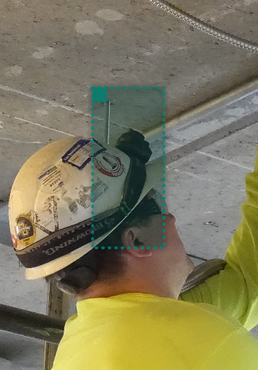
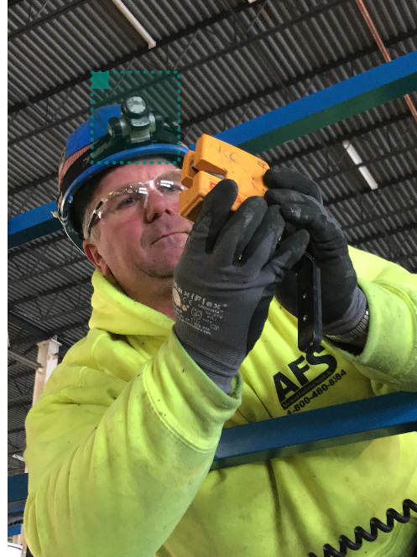
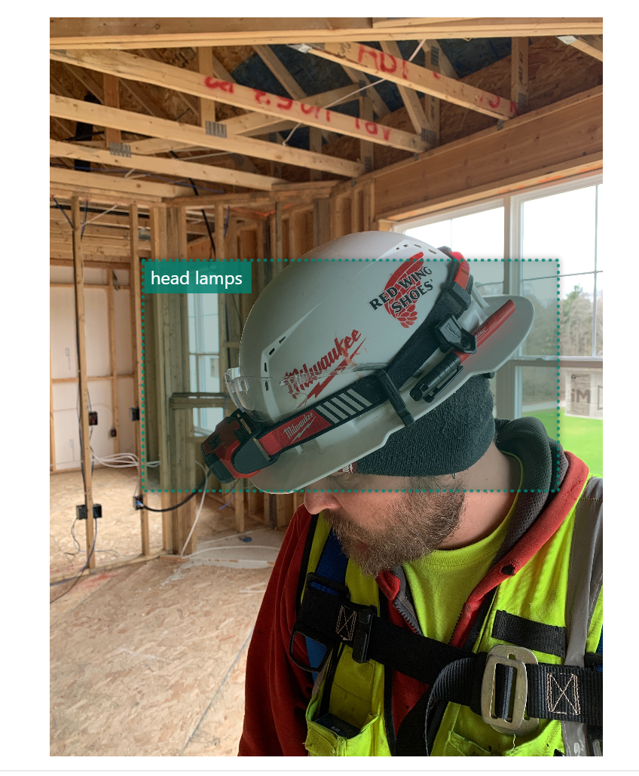
Head Lamps
Head lamps labelled in different scenarios
Cover different angles

Slide 6
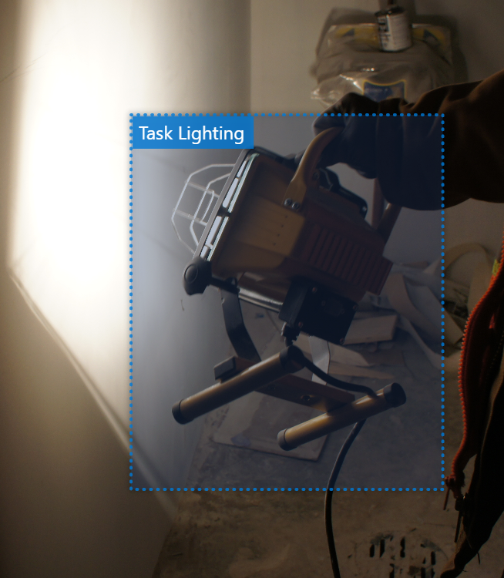
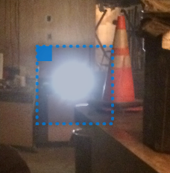
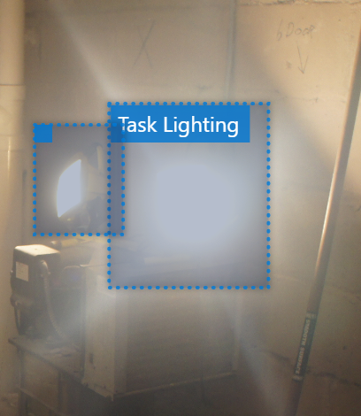
Task Lighting
Lights in various settings
Various angles

Slide 7
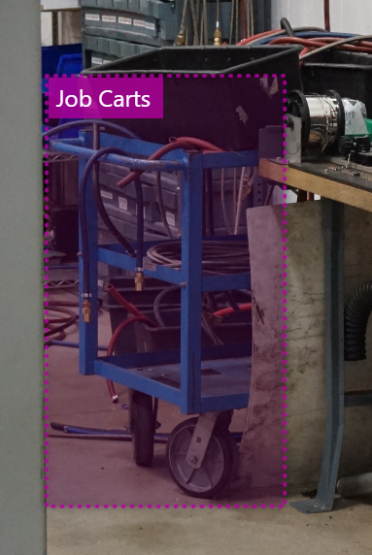
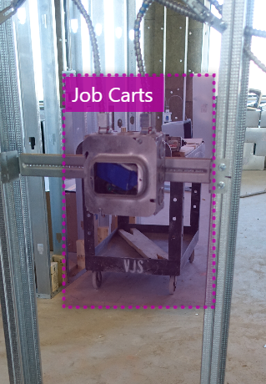
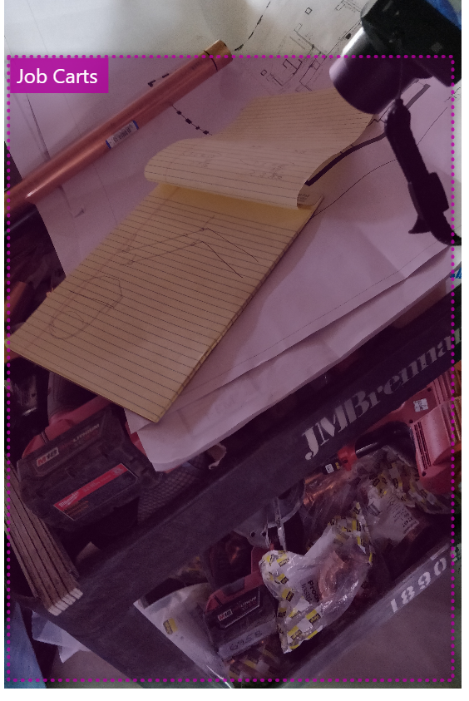
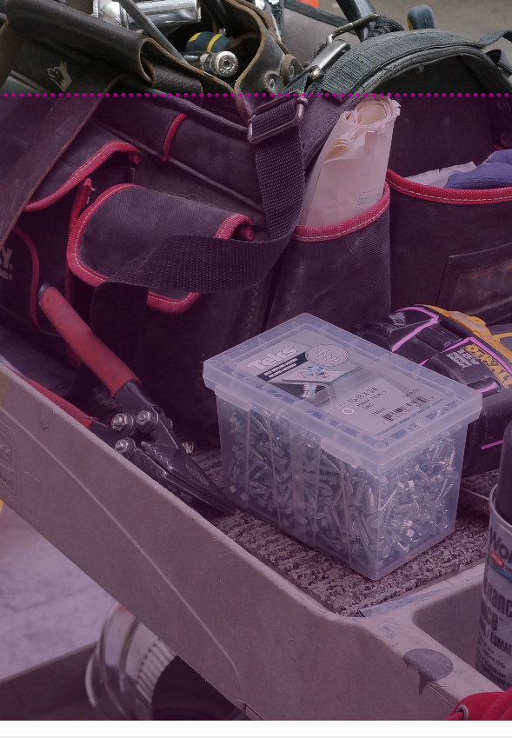
Job Carts

Slide 8
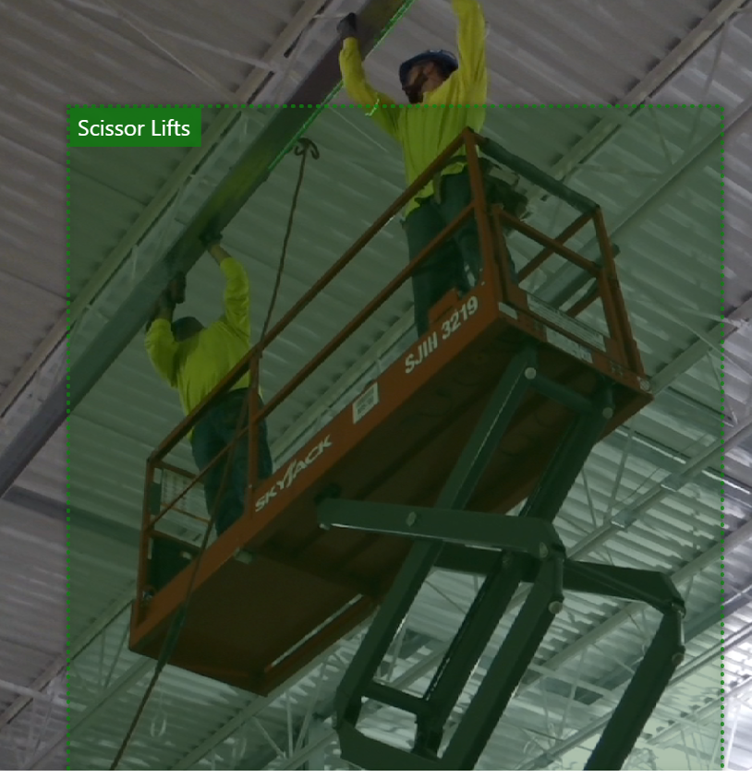
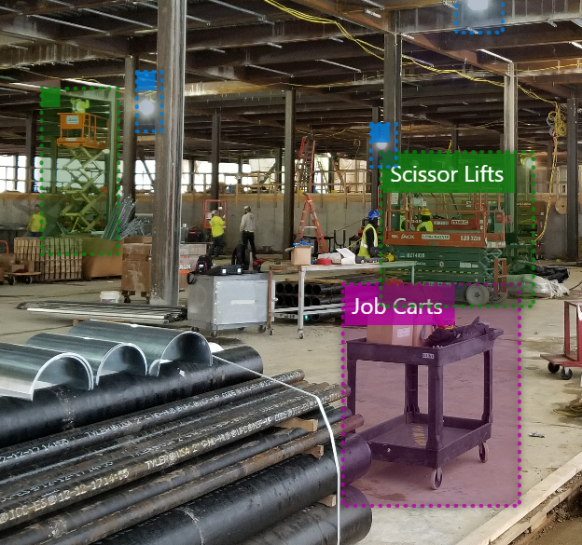
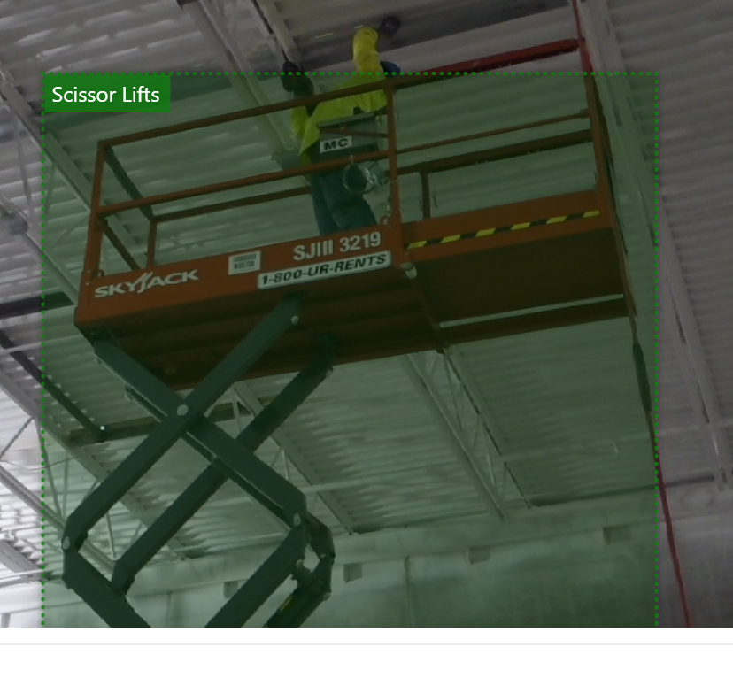
Scissor lift

Slide 9
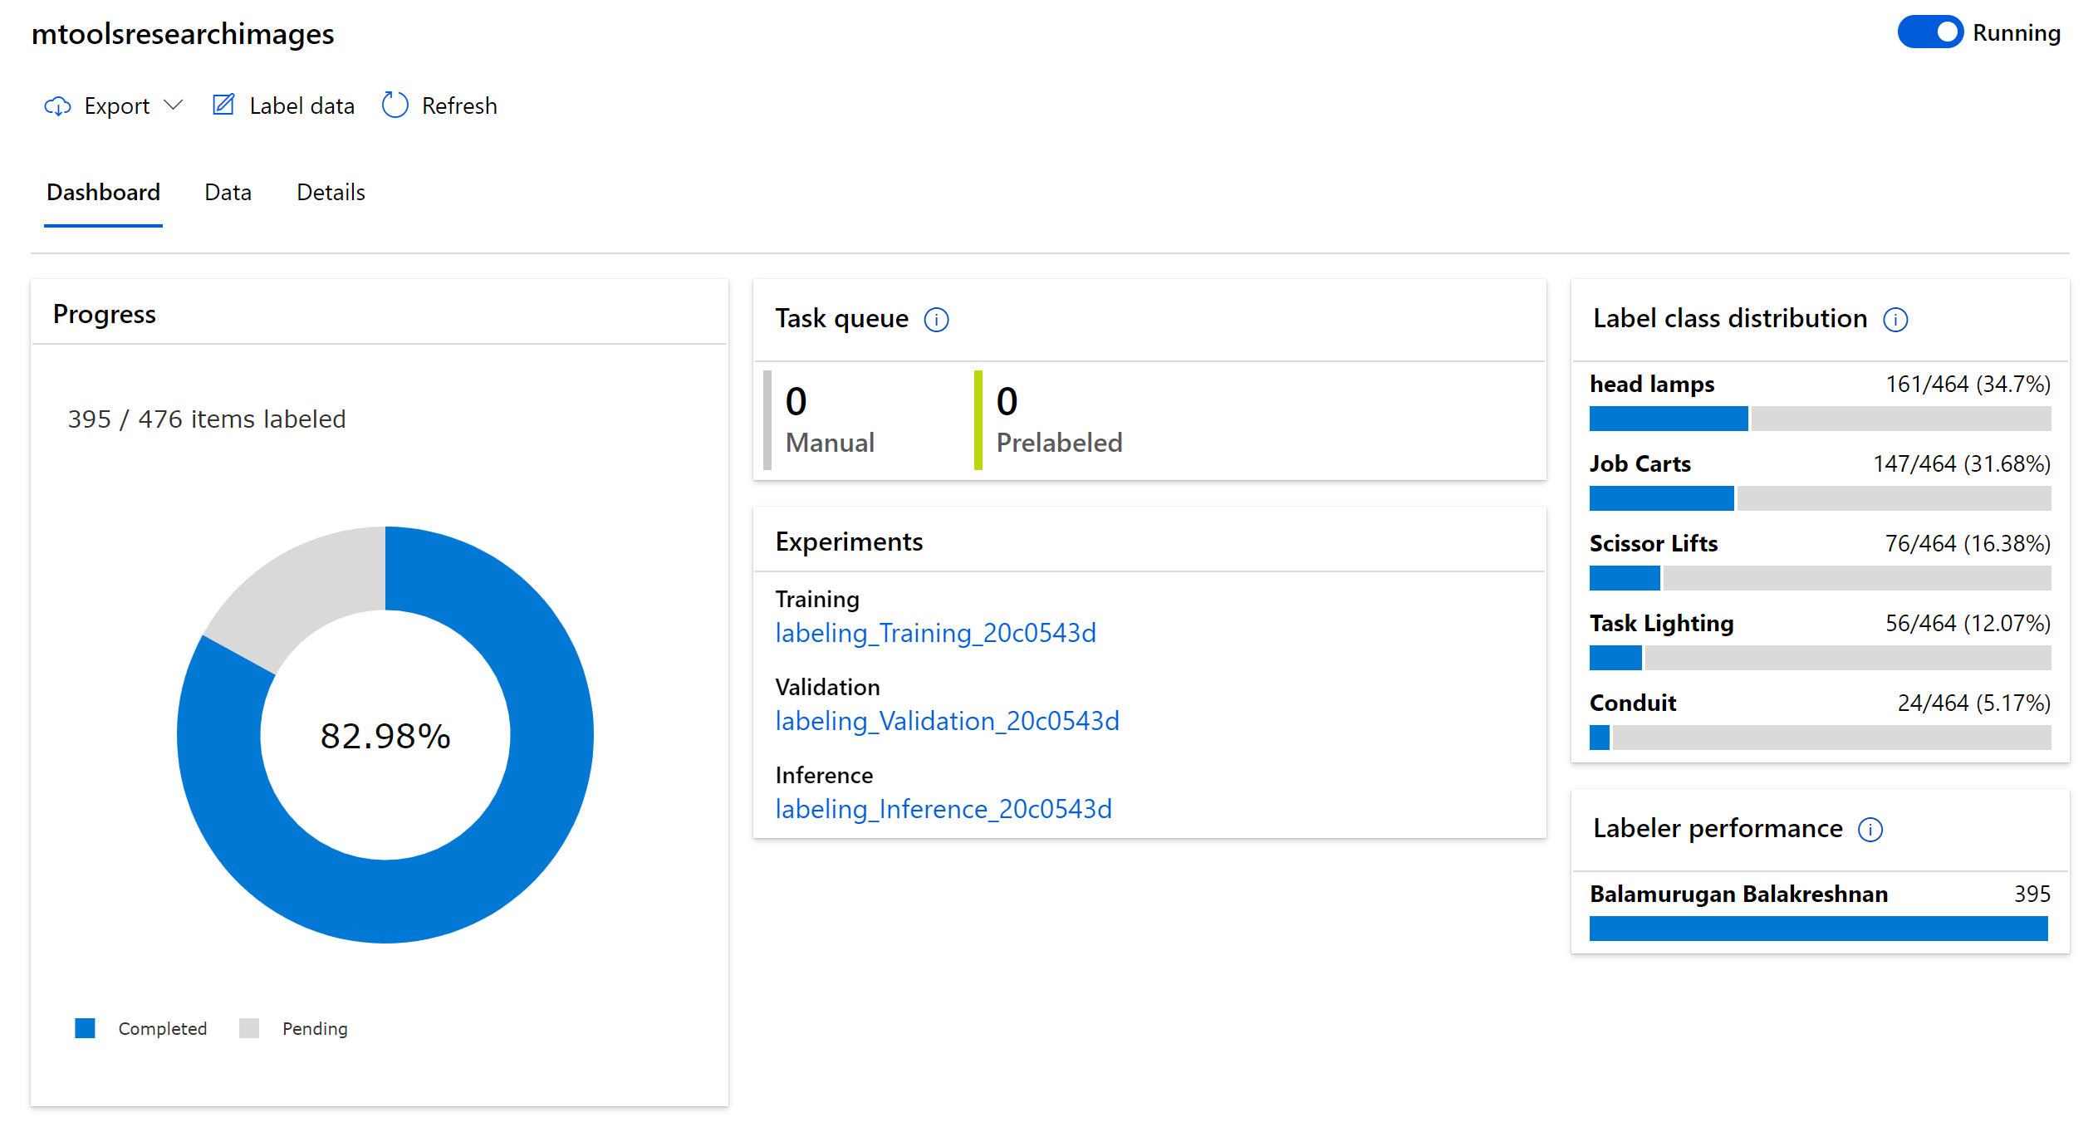

Slide 10
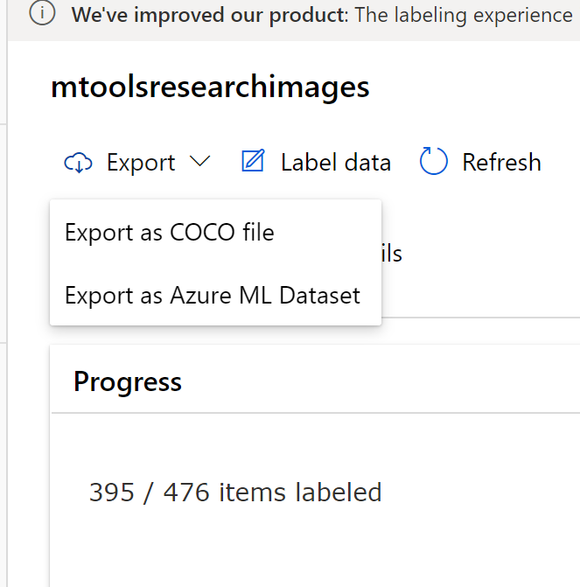
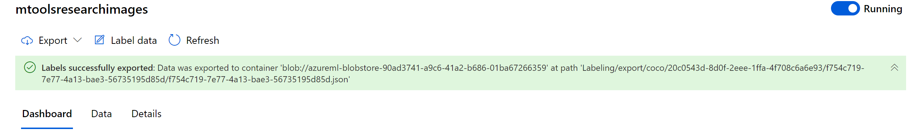
Export

Slide 11
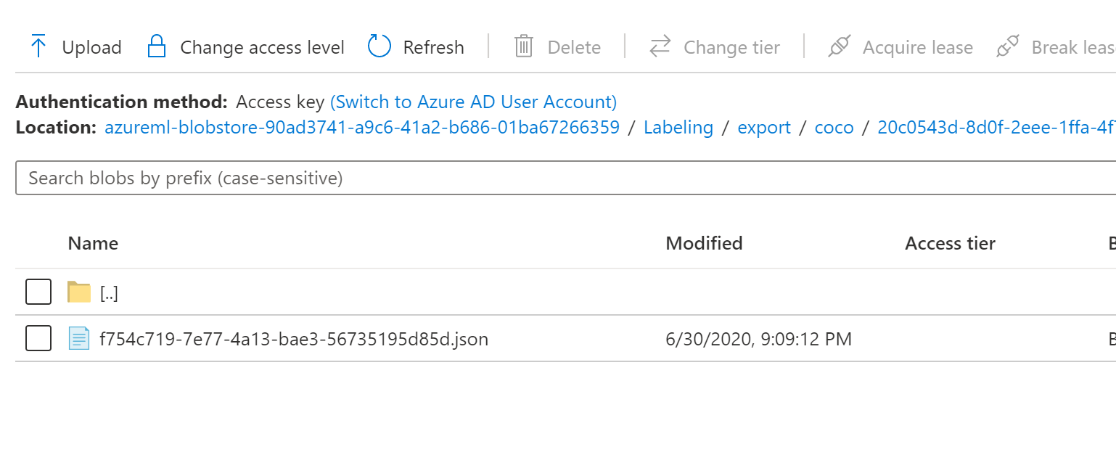
Download JSON COCO file

Slide 12
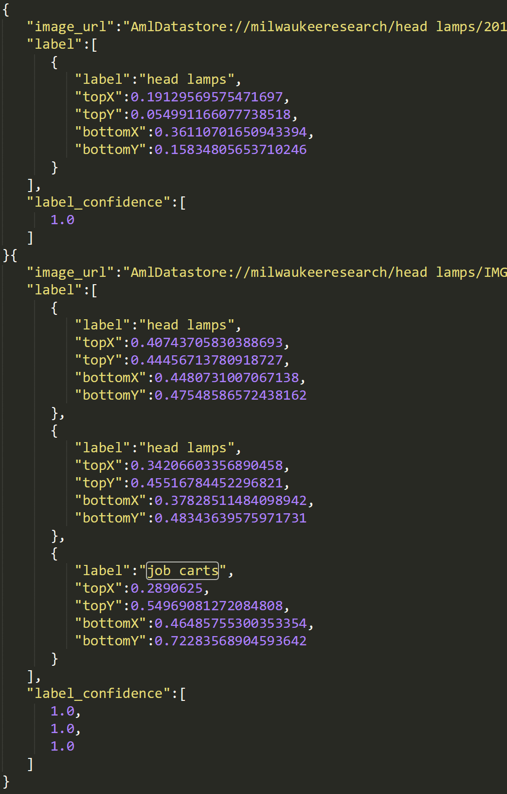
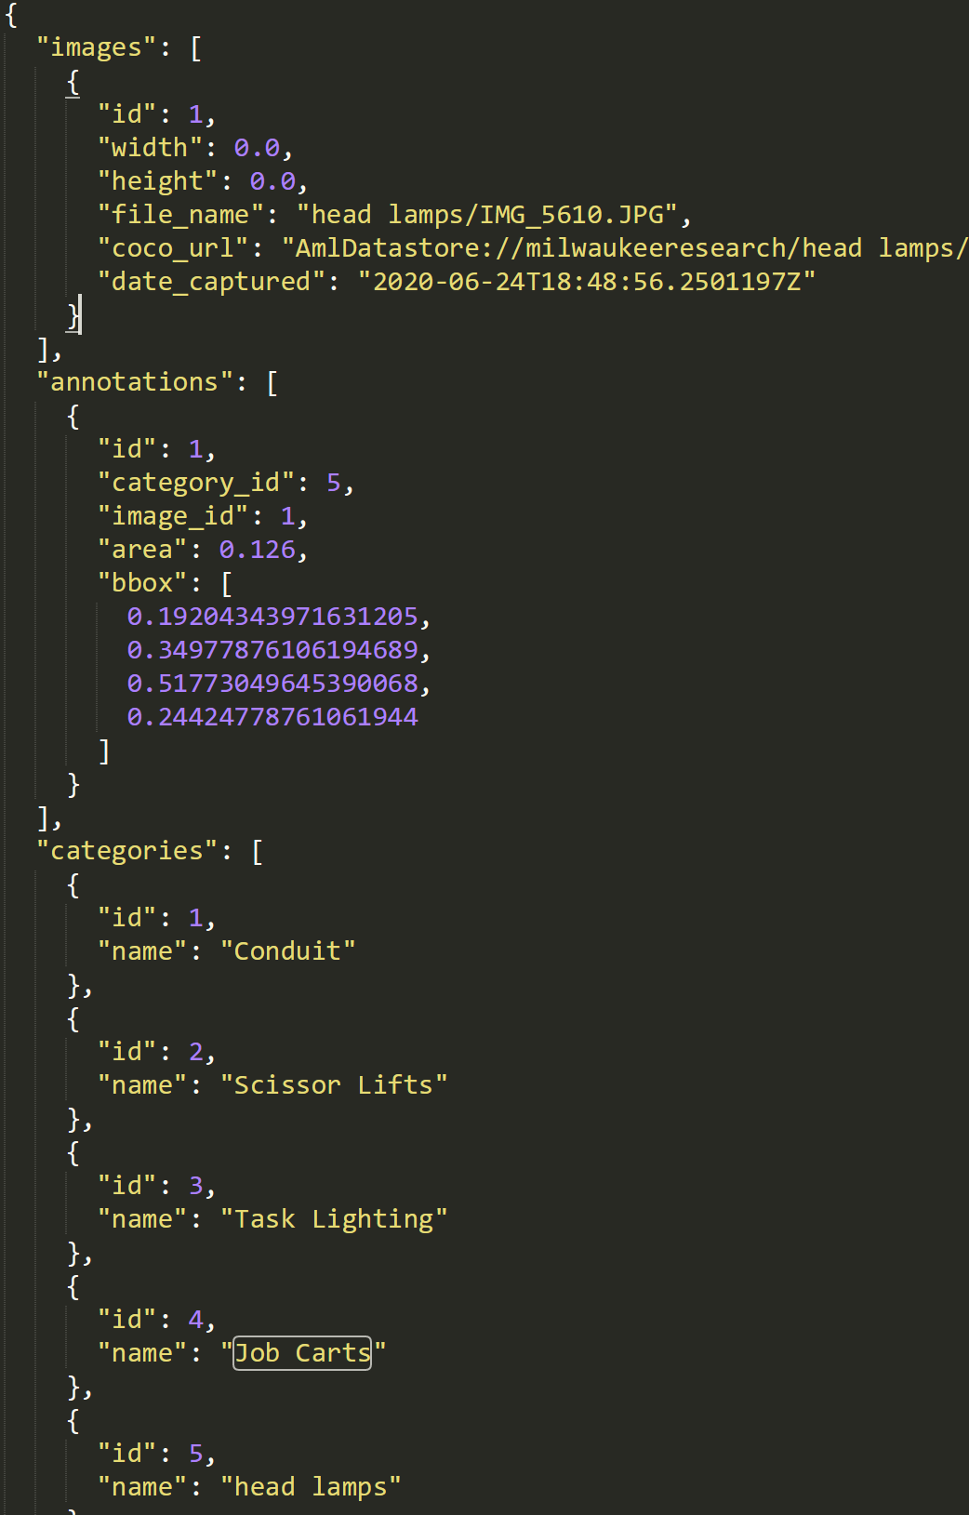
Image Tag Data
1. Exported Label Dataset
2. COCO JSON

Slide 13
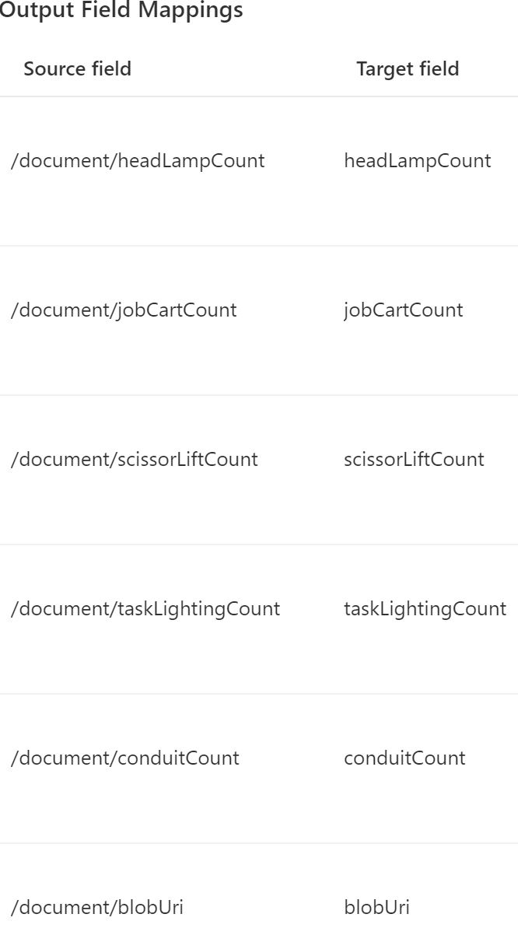
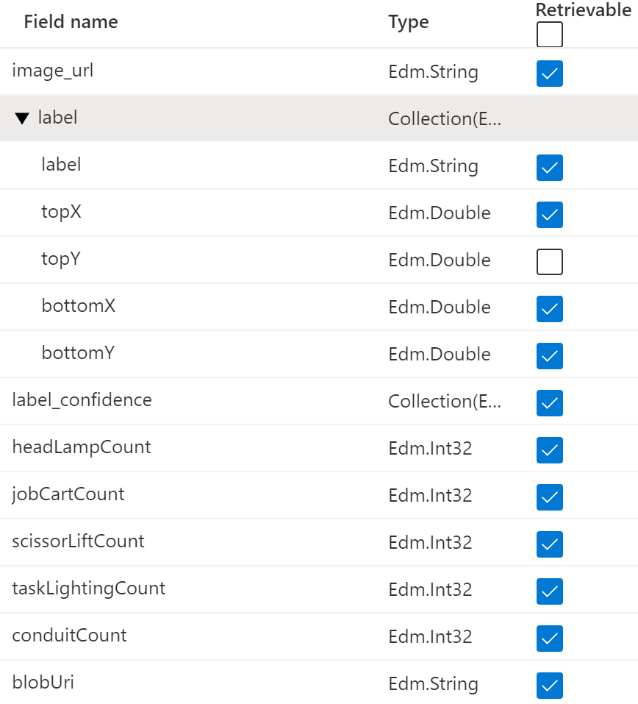


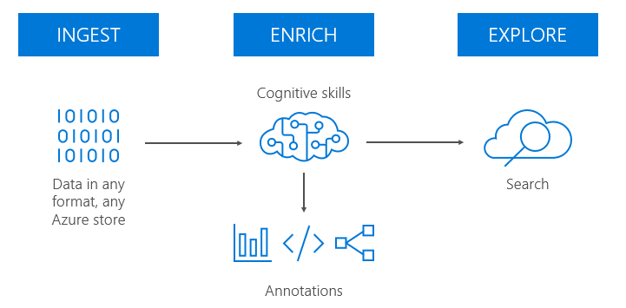
Cognitive Search & Azure Functions

Slide 14

Custom Vision and Computer Vision
Custom Vision/
Computer Vision
Detect:
People
Environment
Text (OCR)
Logos
Images
Labels
Tag data
Notes:
Looking forwards…
Custom Vision and Computer Vision are two image recognition services we offer
Computer Vision has pre-built models you can use to recognize and detect objects such as people, cars, building, the environment (inside or outside)
Can also be used to read typed/handwritten text from an image using OCR

Slide 15
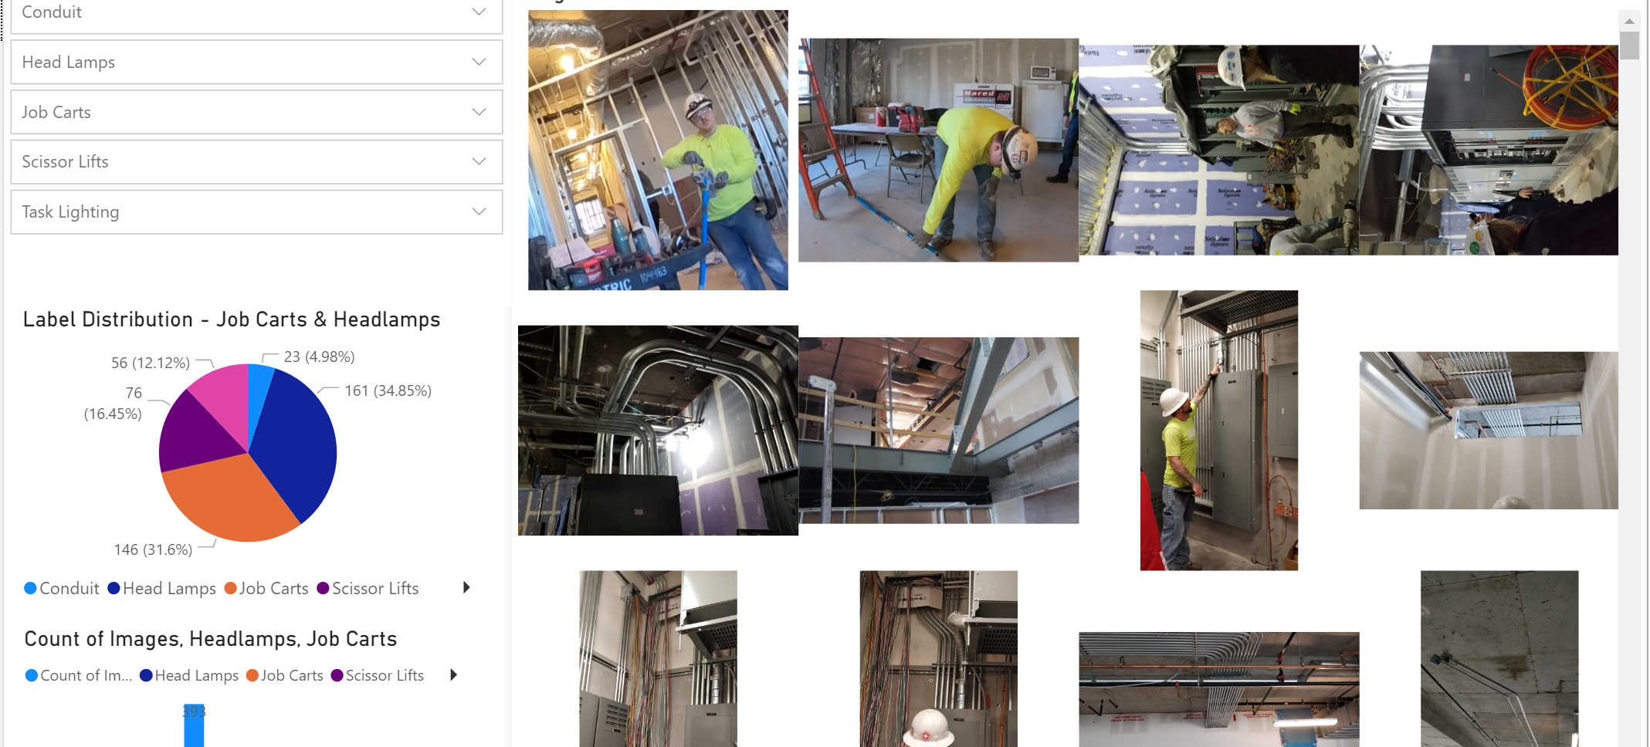
Visual Reporting

